Slide 1
Introduction to CyberSecurity
Sreya Vangara

Slide 2
How are files stored?

Slide 3
How does your computer know the difference between different types of files?
(open “flag”)

Slide 4
File Headers
File headers are used to identify a file by examining the first few bytes of its hexadecimal content.
Ex. jpegs always start with: FF D8 FF
Gifs start with: 47 49 46 38

Slide 5
Problem
Get “flag” to open!
(What does it say?)

Slide 6
Problem
There is a flag hidden in “lion.jpg”. Find it!
Hint: This problem was originally by easyctf

Slide 7
Problem
Get “elif” to open!
Hint: the file name is a clue
Hint: Use Python (or any other coding language)

Slide 8
Steganography
The practice of concealing a file, message, image, or video within another file, message, image, or video.

Slide 9
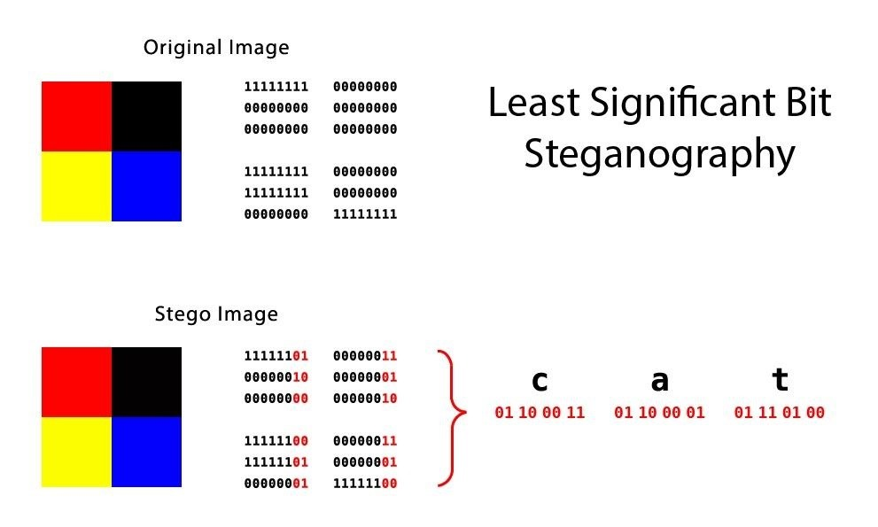
Hidden Data?
How is a pixel stored in memory?
Red, green, and blue values each range from 0-255 (8 bits)
What happens if we change the last bit of each?

Slide 10
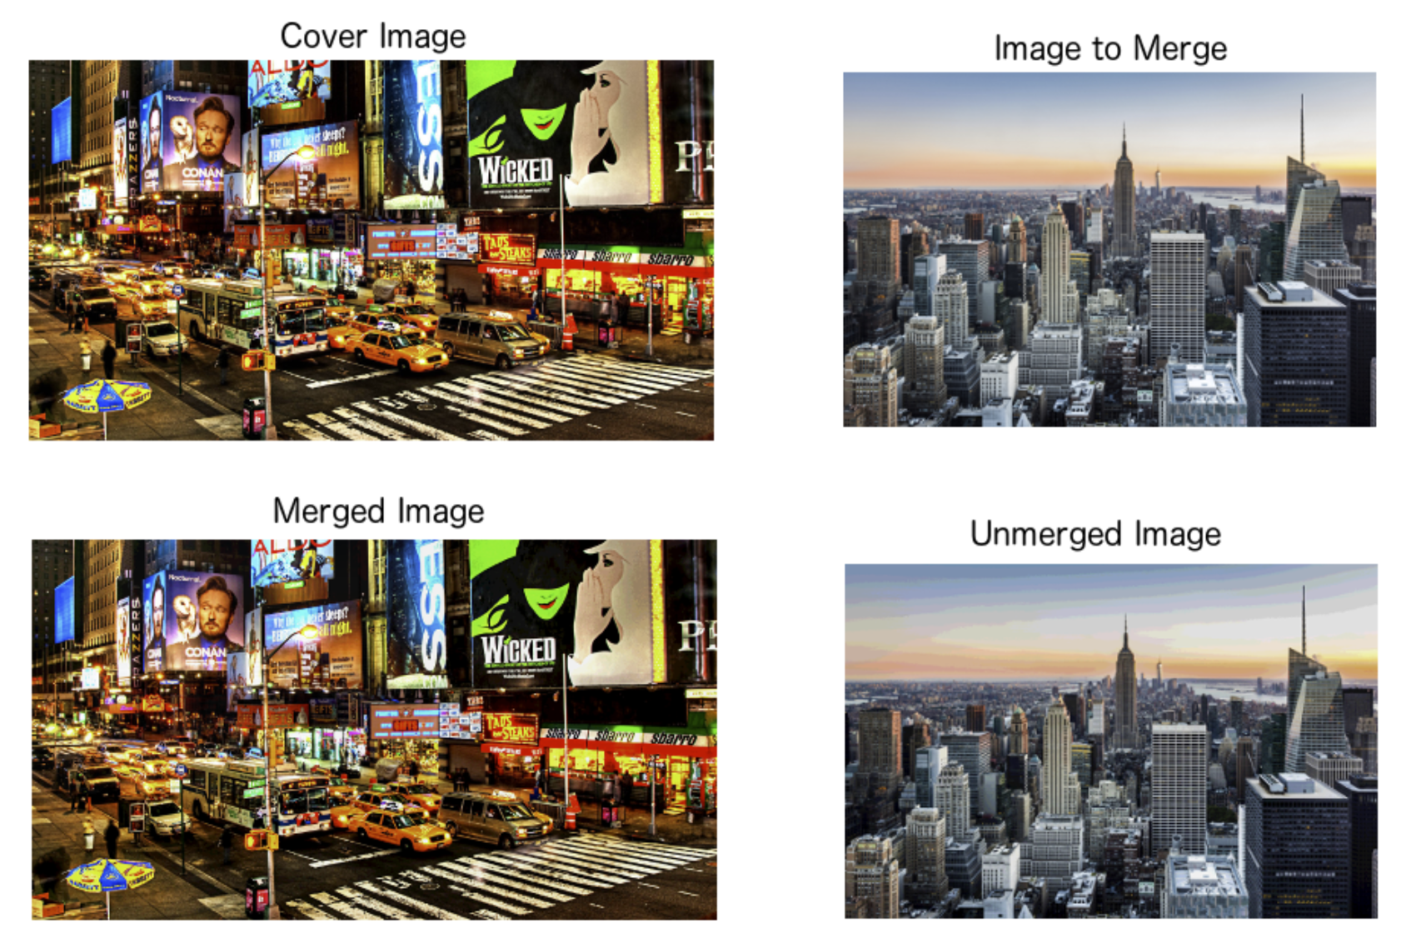

Slide 11
Problem
An evil professor has hurriedly tried to corrupt his filesystem before escaping. We have recovered his hard disk, but need to extract useful data. Can you find what is hidden in “disk”?

Slide 12
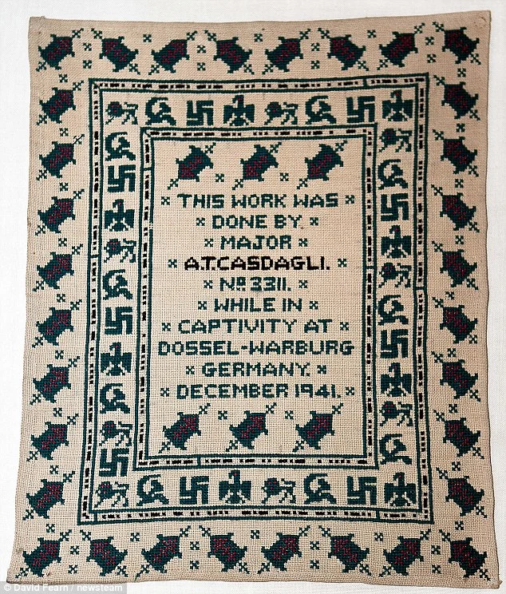
Steganography
Invisible ink in letters
Codes sewn into sweaters
Messages written on envelopes under postage stamps

Slide 13
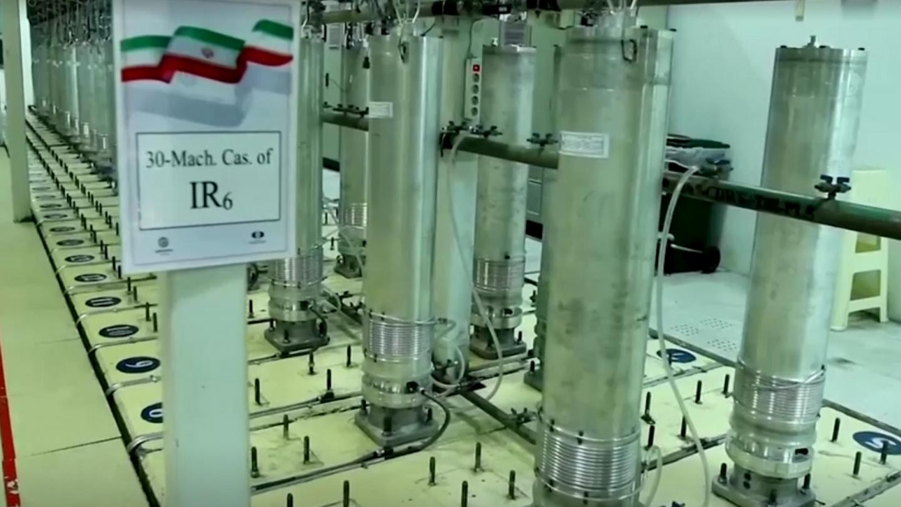
Stuxnet

Slide 14
Problem
Can you solve “find-whats-in-me”?

Slide 15
See you Tomorrow!

